Slide 1
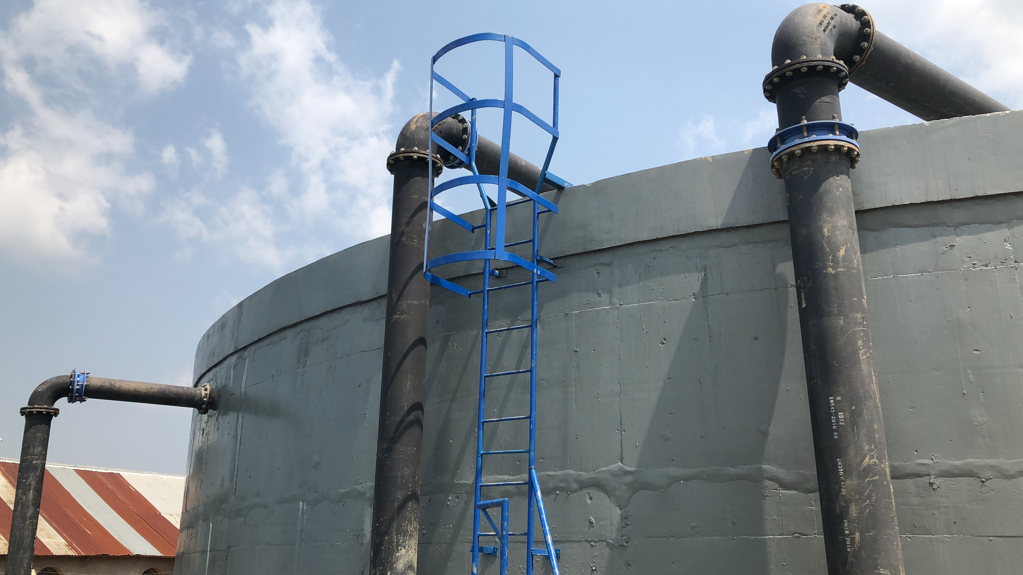
Water and Sanitation DPG
Harriet Nattabi
Alexander Danilenko

Slide 2
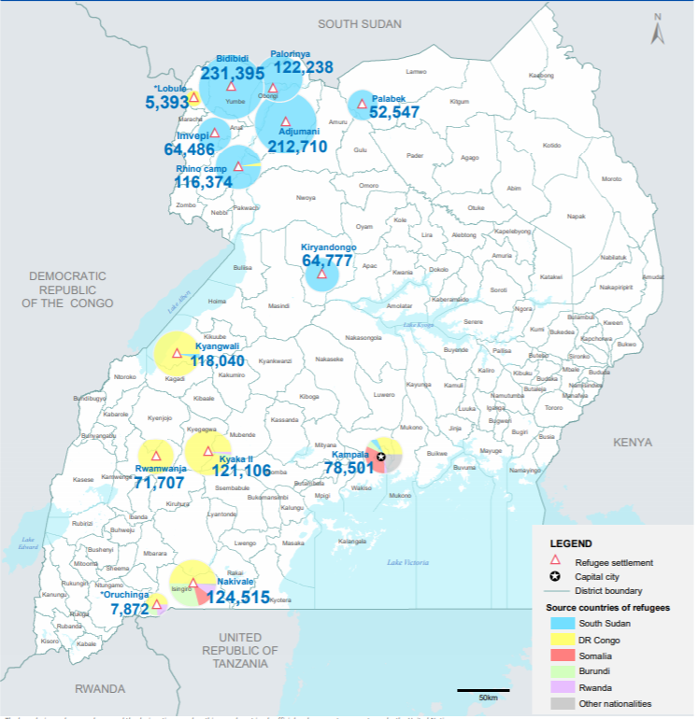
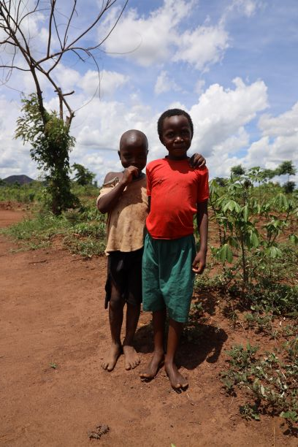
Setting Stage: Lack of inclusive access to water, sanitation and irrigation services, for host and refugees, impacting human capital and climate resilience
51% lack access to safe water
Nominal water access is nearly 80%, however 22 million have no access to safe water Source: JMP 2017
12 districts hosting 1.4 million refugees (3.5% of Uganda population); ~60% refugees hosted in five most remote and least developed districts in the upper West Nile.
81% lack improved sanitation
5% of children are wasted and 33.5% are stunted due to malnutrition and poor sanitation.
Source: American Journal of Health Research 2018, 6(2), p 55
Uganda increasingly vulnerable to droughts and floods, due to land degradation and lack of local water storage (including for irrigation)
Food insecure population to increase from 7m (2015) to 30m (2025)
Notes:
Maps on the right side present water stress risk in Uganda in 2008 and 2035. You can see increase in red (extreme risk of water stress) and orange (high risk). From WB Uganda Climate risk country profile, 2020

Slide 3
Water and Sanitation DPG
Chair recently changed, no co-chair (WaterAID is planned for the role), next transition in September 2021
48 Members
Interaction with PWG was smooth
Inclusion in PIAP development process
DPG key messages/focus are on:
1) strengthening capacity of institutions
2) providing advise and conducting research/analysis, shifting the focus to sanitation, institutional wash and support of the UNHCR, advocating for increased funds, creating incentives
3) sharing knowledge and research amongst the members

Slide 4
Water and Environment Sector Allocations
Water is under Poverty and Inequality Universal Chapter
Ensuring access to Water and Sanitation
Provide the necessities (e.g. water and electricity) to health facilities.
Agriculture and environmental conservation
Provision of rainwater harvesting technologies in rural communities;
Implementation of solar irrigation schemes;
Investment in the construction of multi-purpose water reservoirs;
Irrigation
The MWE and MAAIF to design a comprehensive roadmap for implementation of a national irrigation master plan to guide establishment of irrigation infrastructure. (32.6% of farmers will have access to water by the end of FY20/21) vs. 28.2% 9 in nFY19/20
ALLOCATIONS
FY 19/20: 1,092.8 UGX Billion (3.3% of budget ) FY 20/21: 1,351.0 UGX Billion (4.5% of budget)
GoU: 569 UGX Billion (US$151 mil)
Ext. Partners: 782 UGX Billion (US$209 mil)

Slide 5
Capital Investment in Water Infrastructure
Notes:
Rural Water Supply and Sanitation Programme:- (Total capital investment of UGX 133.95bn bn) construction of 9 gravity Flow Schemes, Retention for 3 GFS, one Highway Sanitation facility; 40 solar powered Water Supply systems, drilling 285 hand pump wells,100 production wells drilled,70 large diameter wells drilled. Urban water supply and sanitation programme (Total capital investment of UGX 621bn)- This will facilitate the construction of 30 Water Supply and Sanitation systems; Rehabilitation of the Piped Water Supply and Sanitation Systems, Complete construction of 4 FSM, 10 Feasibility Studies, Commence Development and Complete Bulk Water Transfer Master Plan, Detailed Designs for 15 Water Supply and Sanitation Systems Developed, Public and Institutional Sanitation Facilities constructed in 5 Towns.
Water for Production Programme: (Total capital investment of UGX 87.26bn). This will facilitate the construction of Bulk Water Supply Schemes including Feasibility Studies for Mega irrigation schemes; Completion of Rwengaaju irrigation scheme in Kabarole District, construction of 12 small scale solar powered irrigation schemes, 20 parish valley tanks,30 small scale irrigation schemes.
Natural Resources Management programme: (Total capital investment of UGX 21 bn ) This will facilitate purchase of Specialized Machinery & Equipment, Assorted tree seedlings for planting in catchment areas, irrigation schemes and other Micro Irrigation schemes procured. Policy, planning and support services (Total capital investment of UGX 7bn ) Construction extension of student dormitory to 100% completion levels . Staff houses renovated and college internal roads resealed; Completion of the regional Ministry of Water and Environment offices.

Slide 6
COVID-19 and Budget
Financing of the sector is not going smoothly:
The GoU contribution to water sector was reduced by nearly 10 percent
DPO US$40 million and US$10 million IWMDP contribution from the GoU budget are still on hold

Slide 7
Moving through FY20/21
Water sector proved its resilience and built-in inertia. Services were provided, and even further expanded, despite the difficulties. National Water and Sewerage Corporation and Umbrella Authorities were able to provide free-of-charge water to informal settlements and to condensed areas during the strictest movement control.
Furthermore, water services from NWSC and UAs became available to many hospitals and to all quarantine centers (who relied in the past on own intakes) and was also provided free-of-charge during April-August 2020 and continued to some through December 2020.

Slide 8
Moving through FY20/21 (2)
The MWE initiated the Comprehensive Refugee Response Plan that, among other things, initiated transfer the water schemes from UNHCR to national providers – NWSC, UAs and district water departments. Several pilots, supported by development partners (AFD, KfW and WB) and extensively managed by UNHCR already started in the North and South. This is coupled by the GoU decision to account refugees into conditional grants allocations to district authorities for water, health and education.
Integrated water resources management approach is now a norm for all water projects.
First commercial loan was given to NWSC by Equity Bank making PPP a reality.

Slide 9
Remaining issues/concerns:
Under the new Program Based Approach to planning and budgeting, water aspects are under three different program working groups which is going to require more resources from the DPs;
Disconnect with HD partners: Institutional wash (many schools and hospitals are either not connected to services or having poor sanitation systems);
Sanitation is fragmented, and seemingly there is no leader in its institutional development;
Last mile in water and sanitation needs to be seriously considered by the providers and DPs: many new water treatment plants and wastewater collection and treatment have been constructed; however, many of them operate below design capacity due to low/absence of connections to it;
Post-COVID-19 recovery will give a chance to review and reconsider many traditional sector development activities. It is specifically related to the speed and efficiency of water system development and monitoring.

